Slide 1
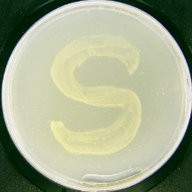
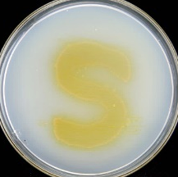
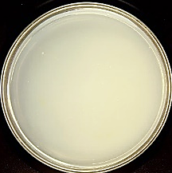
5 mm
2 cm
Blank sandwich agar plate of C.aestuarii
S0825/sandwich agar plate of C.aestuarii
S0825
S0862
F08102
S0825/MA
***
***
***
***
***
***
***
***
***
■ Add Nutrients
■ Mid-log phase
▲ End-log phase
● Stationary phase
1, Negative control (MB)
2, Positive control (cell lysate)
3, >10 kDa fraction of Cell lysate
4, <10 kDa fraction of Cell lysate
5, MB with 1mg/mL nucleic acid
6, MB with 1mg/mL polysaccharide
7, Cell lysate treated with proteinase K
8, Cell lysate treated with heating
■
■
▲
●
■
▲
■
▲
●
Control
(MB)
Spent-culture supernatant
OD₆₀₀=2.04
OD₆₀₀=1.22
OD₆₀₀=0.64
Cell lysate biomass
Notes:
D,e

Slide 2
5 mm
2 cm
Blank sandwich agar plate of C.aestuarii
S0825/sandwich agar plate of C.aestuarii
S0825
S0862
F08102
S0825/MA
***
***
***
***
***
***
***
***
***
1, Negative control (MB)
2, Positive control (cell lysate)
3, >10 kDa fraction of Cell lysate
4, <10 kDa fraction of Cell lysate
5, MB with 1mg/mL nucleic acid
6, MB with 1mg/mL polysaccharide
7, Cell lysate treated with proteinase K
8, Cell lysate treated with heating
■ Add Nutrients
■ Mid-log phase
▲ End-log phase
● Stationary phase
■
■
▲
●
■
▲
■
▲
●
Control
(MB)
Spent-culture supernatant
OD₆₀₀=2.04
OD₆₀₀=1.22
OD₆₀₀=0.64
Cell lysate biomass
Notes:
D,e

